Slide 2
Strategy is implemented through projects.
Every project should have a clear link to the organization’s strategy.
2–<number>

Slide 3
Why Project Managers Need to Understand the Strategic Management Process
  Many organizations cannot identify a project’s priority and link it with the strategic plan.
  How can organization ensure this link and alignment?
  Integration assumes the existence of a strategic plan and a process for prioritizing projects by their contribution to the plan.
2–<number>

Slide 4
Why Project Managers Need to Understand the Strategic Management Process
Changes in the organization’s mission and strategy
  Project managers must respond to changes with appropriate decisions about future projects and adjustments to current projects.
  Project managers who understand their organization’s strategy can become effective advocates of projects aligned with the firm’s mission.
2–<number>

Slide 5
Projects and Strategy
Mistakes caused by not understanding the role of projects in accomplishing strategy:
  Focusing on problems or solutions with low strategic priority.
  Focusing on the immediate customer rather than the whole market place and value chain.
  Overemphasizing technology that results in projects that pursue exotic technology that does not fit the strategy or customer need.
  Engaging in a never-ending search for perfection that no one except the project team really cares about.
2–<number>

Slide 6
The Strategic Management Process:
An Overview
Strategic Management
  Requires every project to be clearly linked to strategy.
  Provides theme and focus of firm’s future direction.
    Responding to changes in the external environment—environmental scanning
    Allocating scarce resources of the firm to improve its competitive position—internal responses to new programs
  Requires strong links among mission, goals, objectives, strategy, and implementation.
2–<number>

Slide 7
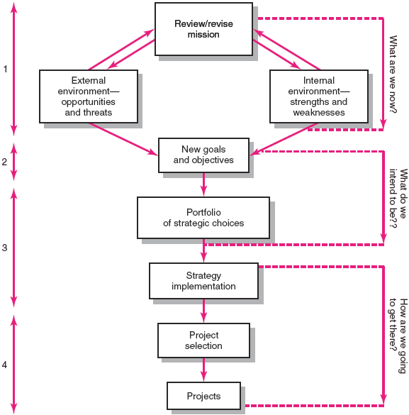
Strategic Management Process
2–<number>

Slide 8
The Strategic Management Process:
An Overview
Four Activities of the Strategic Management Process
  Review and define the organizational mission.
  Set long-range goals and objectives.
  Analyze and formulate strategies to reach objectives.
  Implement strategies through projects
2–<number>

Slide 9
1- Mission Statement
Mission statements (MS) identify both the mission «what are we now » and lead to the long term objectives or goals «what we want to become»
It is about products and services, include organizational philosophy, key technologies, public image, contribution to society, target markets, change infrequently.
Mission statements communicates and identifies the purpose of the organization to all stakeholders.
2–<number>

Slide 10
Mission Statement
Boeing Mission:
We are constantly re-examining our capabilities and processes to ensure that our company is as strong and vital as our heritage. In fact, our culture mirrors the heritage of aviation itself, built on a foundation of innovation, aspiration and imagination.”
Boeing Vision: "People working together as a global enterprise for aerospace leadership.”
http://retailindustry.about.com/od/retailbestpractices/ig/Company-Mission-Statements/Boeing-Mission-Statement---Vision.htm
2–<number>

Slide 11
Boeing Mission Statement
Boeing Business Strategy:
"Detailed customer knowledge and focus that understand, anticipate and respond to customer needs.
Large-scale systems integration that continually develops and advances technical excellence.
A lean enterprise characterized by efficiency, supplier management, short cycle times, high quality and low transaction costs.”
2–<number>

Slide 12
Mission Statement
Airbus Vision/Mission:
http:/
“Creating the best and safest aircraft is Airbus’ mission”
PASSENGER AT HEART, AIRLINE IN MIND
Airbus' mission is to meet the needs of airlines and operators by producing the most modern and comprehensive aircraft family on the market, complemented by the highest standard of product support.
2–<number>

Slide 13
2- Characteristics of Objectives
S Specific Be specific in targeting an objective
M Measurable Establish a measurable indicator(s) of progress
A Assignable Make the objective assignable to one person for completion
R Realistic State what can realistically be done with available resources
T Time related State when the objectives can be achieved
Organizational objectives drive your projects.
2–<number>

Slide 14
3- Analyze and Formulate Strategies to Reach Objectives
Strategies – answer questions «how are we going to get there» or what needs to be done to reach our objectives
Components are:
  1. Understand past & current position of the organization- customer needs,
  2. Assemment of the internal environment (resources), and external environment (competitors, regulations, etc.) SWOT analysis, identify core competencies
  3. Portfolio of strategic alternatives are identified. Should support mission and objectives.
  4. Implement strategies through projects
2–<number>

Slide 15
4- Implementation through Projects
Strategy Implementation lacks structure that is usually available for Strategy Formulation
Implementation requires action and completing tasks:
Allocation of resources (across projects)
A formal and informal organization that supports strategy and projects
Planning and control systems to be sure, activities are effectively performed
Motivating project contributors
Prioritizing projects – without implementation, success is impossible
2–<number>

Slide 16
Project Portfolio Management Problems
The Implementation Gap
  The lack of understanding and consensus on strategy among top management and middle-level (functional) managers who independently implement the strategy.
Organization Politics
  Project selection is based on the persuasiveness and power of people advocating the projects.
Resource Conflicts and Multitasking
  Multiproject environment creates interdependency relationships of shared resources which results in the starting, stopping, and restarting projects.
2–<number>

Slide 17
Benefits of Project Portfolio Management
Builds discipline into project selection process.
Links project selection to strategic metrics.
Prioritizes project proposals across a common set of criteria, rather than on politics or emotion.
Allocates resources to projects that align with strategic direction.
Balances risk across all projects.
Justifies killing projects that do not support organization strategy.
Improves communication and supports agreement on project goals.
2–<number>

Slide 18
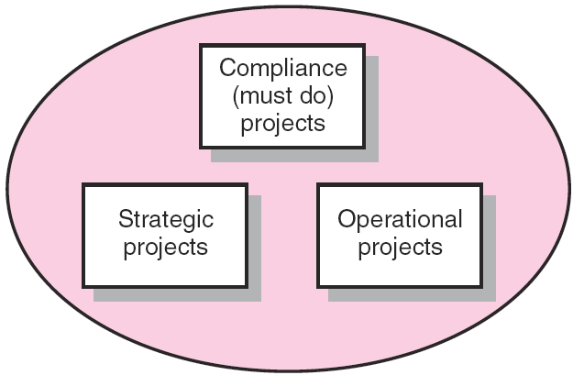
Portfolio of Projects by Type
A classification of types of Projects. (Ex1,p.50)
FIGURE 2.2
Copyright © 2006 The McGraw-Hill Companies. All rights reserved.
McGraw-Hill/Irwin 2–<number>

Slide 19
A Portfolio Management System
Compliance projects are those needed to meet regulatory conditions required to operate in a region – “must do” projects.
Emergency projects such as rebuilding a factory destroyed by fire or earthquake.
Compliance and emergency projects usually have penalties if thy are not implemented.
2–<number>

Slide 20
A Portfolio Management System
Operational projects are those that are needed to support current operations.
These projects are designed to improve efficiency of delivery systems, reduce project costs, and improve performance.
TQM projects are examples of operational projects.
2–<number>

Slide 21
A Portfolio Management System
Strategic projects are those that directly support the organization’s long run mission.
These projects are directed towards increasing revenue or market share.
Examples are new projects, research & developments projects.
2–<number>

Slide 22
A Portfolio Management System
Design of a project portfolio system:
  Classification of a project
  Selection criteria depending upon classification
  Sources and solicitation of project proposals
  Evaluating proposals
  Managing the portfolio of projects.
2–<number>

Slide 23
A Portfolio Management System
Selection Criteria
  Financial: payback, net present value (NPV), internal rate of return (IRR)
  Non-financial: projects of strategic importance to the firm.
Multi-Weighted Scoring Models
  Use several weighted selection criteria to evaluate project proposals.
2–<number>

Slide 24
Financial Models
The Payback Model
  Measures the time the project will take to recover
  the project investment.
  Uses more desirable shorter paybacks.
  Emphasizes cash flows, a key factor in business.
Limitations of Payback:
  Ignores the time value of money.
  Assumes cash inflows for the investment period
  (and not beyond).
  Does not consider profitability.
2–<number>

Slide 25
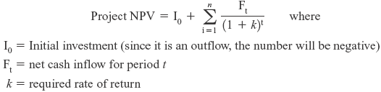
Financial Models (cont’d)
The Net Present Value (NPV) model
  Uses management’s minimum desired rate-of-return (discount rate) to compute the present value of all net cash inflows.
    Positive NPV: the project meets the minimum desired rate of return and is eligible for further consideration.
    Negative NPV: project is rejected.
Copyright © 2006 The McGraw-Hill Companies. All rights reserved.
McGraw-Hill/Irwin 2–<number>

Slide 26
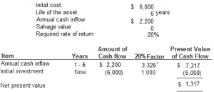
Example NPV
Compute net present value (NPV) of this investment project.
Should the equipment be purchased according to NPV analysis?
Project:
(1) Computation
net present value:
(2) Decision:
Yes, the equipment should be purchased because the net present value is positive ($1,317). Having a positive net present value means the project promises a rate of return that is higher than the minimum rate of return required by management (20% in the above example).
In the above example, the minimum required rate of return is 20%. The minimum required rate of return (20% in our example) is used to discount the cash inflow to its present value and is, therefore, aka as discount rate.
Copyright © 2006 The McGraw-Hill Companies. All rights reserved.
McGraw-Hill/Irwin 2–<number>

Slide 27
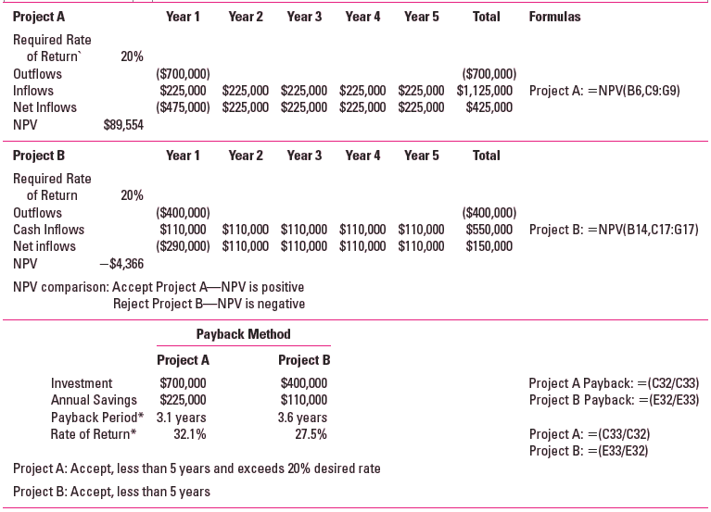
Net Present Value (NPV) and Internal Rate of Return (IRR):
Example Comparing Two Projects
EXHIBIT 2.3
Copyright © 2006 The McGraw-Hill Companies. All rights reserved.
McGraw-Hill/Irwin 2–<number>

Slide 28
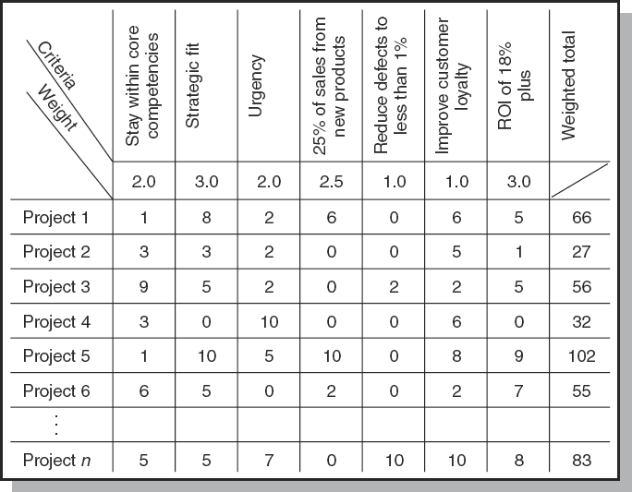
Project Screening Matrix
FIGURE 2.3
Copyright © 2006 The McGraw-Hill Companies. All rights reserved.
McGraw-Hill/Irwin 2–<number>

Slide 29
Nonfinancial Strategic Criteria
To capture larger market share
To make it difficult for competitors to enter the market
To develop an enabler product, which by its introduction will increase sales in more profitable products
To develop core technology that will be used in next-generation products
To reduce dependency on unreliable suppliers
To prevent government intervention and regulation
2–<number>

Slide 30
Multi-Criteria Selection Models
Checklist Model
  Uses a list of questions to review potential projects and to determine their acceptance or rejection.
  Fails to answer the relative importance or value of a potential project and doesn’t allow for comparison with other potential projects.
Multi-Weighted Scoring Model
  Uses several weighted qualitative and/or quantitative selection criteria to evaluate project proposals.
  Allows for comparison of projects with other potential projects
2–<number>

Slide 31
Applying a Selection Model
Project Classification
  Deciding how well a strategic or operations project fits the organization’s strategy.
Selecting a Model
  Applying a weighted scoring model to bring projects to closer with the organization’s strategic goals.
    Reduces the number of wasteful projects
    Helps identify proper goals for projects
    Helps everyone involved understand how
    and why a project is selected
2–<number>

Slide 32
Project Proposals
Sources and Solicitation of Project Proposals
  Within the organization
  Request for proposal (RFP) from external sources (contractors and vendors)
Ranking Proposals and Selection of Projects
  Prioritizing requires discipline, accountability, responsibility, constraints, reduced flexibility,
  and loss of power.
Managing the Portfolio
  Senior management input
  The priority team (project office) responsibilities
2–<number>

Slide 33
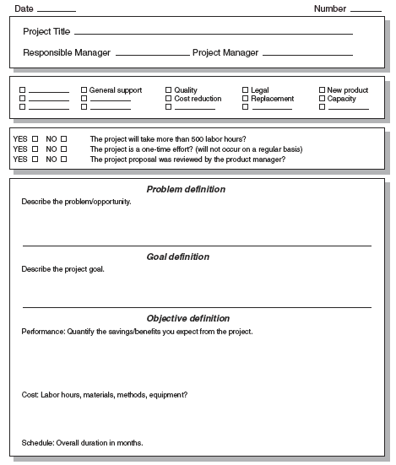
Major Project Proposal
FIGURE 2.4A
Copyright © 2006 The McGraw-Hill Companies. All rights reserved.
McGraw-Hill/Irwin 2–<number>

Slide 34
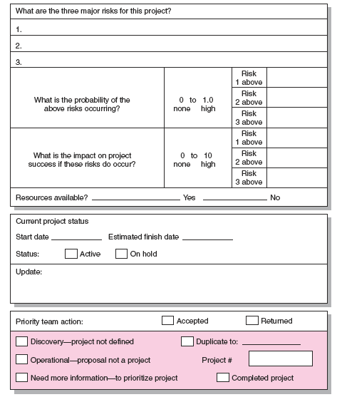
Risk
Analysis
FIGURE 2.4B
Copyright © 2006 The McGraw-Hill Companies. All rights reserved.
McGraw-Hill/Irwin 2–<number>

Slide 35
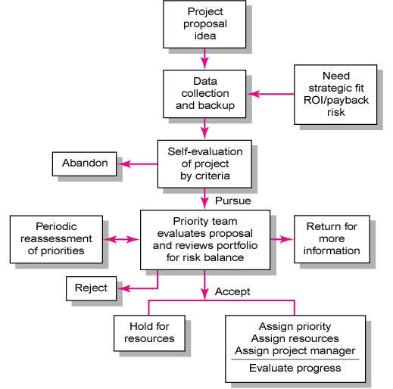
Project Screening Process
FIGURE 2.5
Copyright © 2006 The McGraw-Hill Companies. All rights reserved.
McGraw-Hill/Irwin 2–<number>

Slide 36
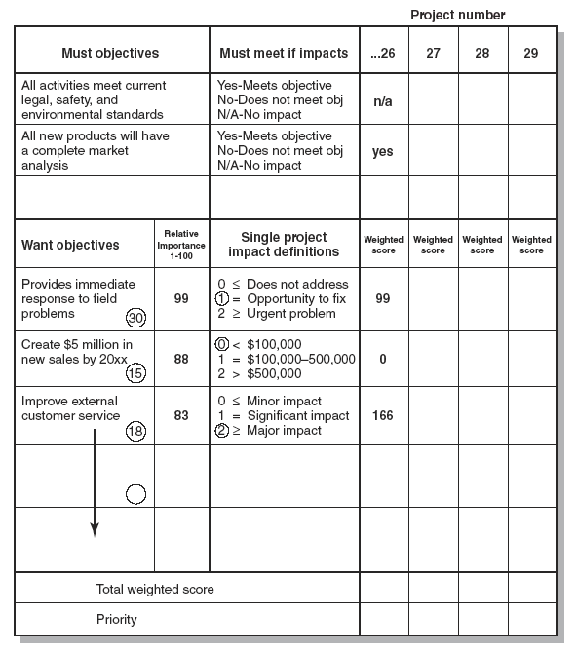
Priority
Analysis
FIGURE 2.6
Copyright © 2006 The McGraw-Hill Companies. All rights reserved.
McGraw-Hill/Irwin 2–<number>

Slide 37
Managing the Portfolio
Senior Management Input
  Provide guidance in selecting criteria that are aligned with the organization’s goals
  Decide how to balance available resources among current projects
The Priority Team Responsibilities
  Publish the priority of every project
  Ensure that the project selection process is open and free of power politics.
  Reassess the organization’s goals and priorities
  Evaluate the progress of current projects
2–<number>

Slide 38
Balancing the Portfolio for Risks and Types of Projects
Balancing the portfolio of projects is as important as project selection.
Organizations need to evaluate each new project in terms of what it adds to the project mix.
Short-term needs need to be balanced with the long-term potential.
Resource usage needs to be optimized across all projects, not just the most important project.
2–<number>

Slide 39
Balancing the Portfolio for Risks and Types of Projects
Two types of risks are associated with projects:
  Risk associated with the total portfolio of projects, which should reflect the organization’s risk profile.
  Second are specific project risks that can inhibit the execution of a project , such as schedule, cost and technical.
2–<number>

Slide 40
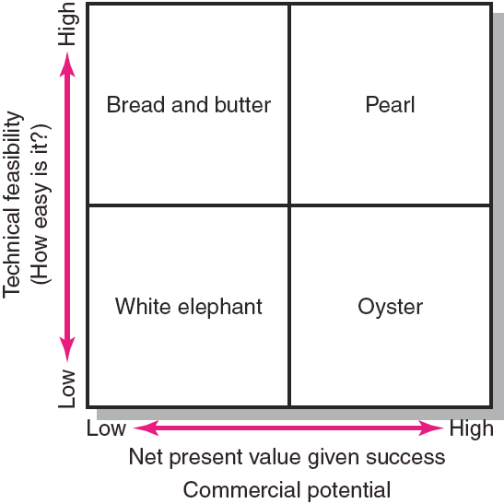
Project Portfolio Matrix
FIGURE 2.7
Copyright © 2006 The McGraw-Hill Companies. All rights reserved.
McGraw-Hill/Irwin 2–<number>

Slide 41

Project Portfolio Matrix Dimensions
Bread-and-butter Projects
  Involve evolutionary improvements
  to current products and services.
Pearls
  Represent revolutionary commercial opportunities using proven technical advances.
Oysters
  Involve technological breakthroughs
  with high commercial payoffs.
White Elephants
  Showed promise at one time
  but are no longer viable.
2–<number>

Slide 42
Key Terms
Implementation gap
Net present value
Organizational politics
Payback
Priority system
Priority team
Project portfolio
Project screening matrix
Project sponsor
Sacred cow
Strategic management process
2–<number>

